Slide 1
EDT 500 FINAL PROJECT
Fall 2011

Slide 2
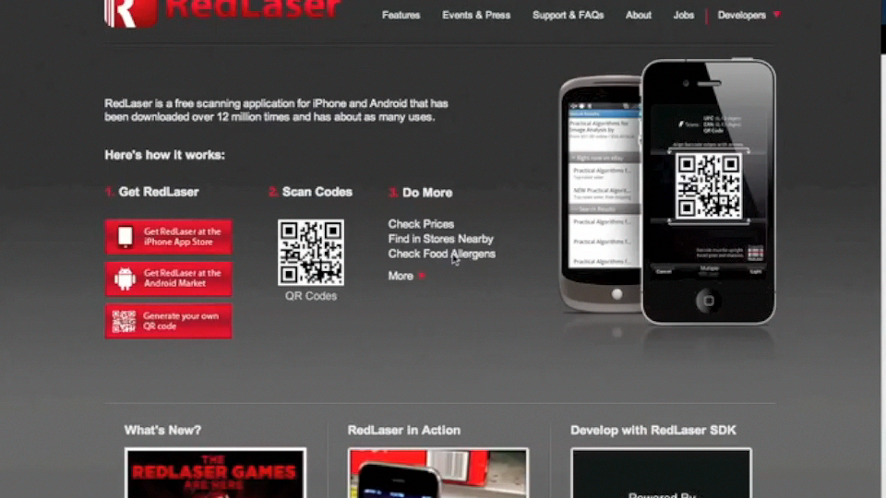
Lesson 1
Creating QR Codes
This video was created to attach to my website in order that other faculty can view the video on their own time and explore creating QR codes.
QR codes will be an invaluable tool in the classroom. Calendar events can be attached to test reviews in order that students can like the event directly to their phone. URL QR codes create links to websites to avoid clutter of large URL’s while creating a way for students to directly go to a website from their phone from printed material

Slide 3




QR Codes to My Teacher Pages
Freshman
Sophomores
Juniors
Seniors

Slide 4
Lesson 2
QR Scavenger Hunt
The objective of this lesson is to facilitate transition to the high school for incoming 9th grade students.
The students will pick up an iPad from the main office and begin a self guided tour of the building visiting many of the classrooms that they will be attending while at the high school.
QR codes will be placed throughout the building at various points for students to scan and proceed to the next part of the building
As part of the red laser app, scans are logged in the history of the app, so staff can monitor if the students have been to all required locations.

Slide 5
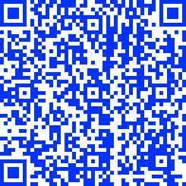
Period 1 – English
Congratulations! You have successfully made it to English class with Mr. Lombardo.
Your next class is Algebra with Mr. Mooney in room w203.

Slide 6
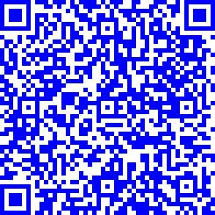
Period 2 - Algebra
Congratulations! You have successfully made it to Algebra class with Mr. Mooney.
Your next class is Art with Mrs. Glick in room c103.

Slide 7
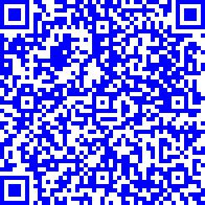
Period 3 - Art
Congratulations! You have successfully made it to Art class with Mrs. Glick.
Your next class is Earth Science with Mr. Tinker in room w121.

Slide 8
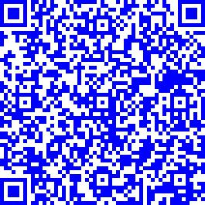
Period 4 – Earth Science
Congratulations! You have successfully made it to Earth Science class with Mr. Tinker.
Your next class is Health/PE with Mr. Filon, Ms. Fisher, and Mrs. LeFevre in room e104.

Slide 9
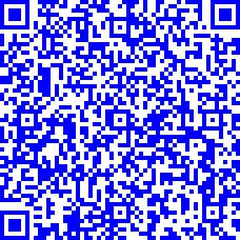
Period 5 – Health/PE
Congratulations! You have successfully made it to Health/PE.
Your next class is World History with Mrs. Sanborn, but you need to eat lunch first.
Find the lunch line next to the Orchestra Room.

Slide 10
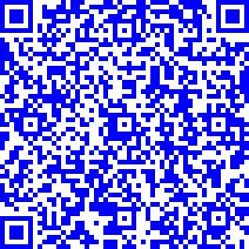
Period 6 – World History
Congratulations! You have successfully made it to World History class with Mrs. Sanborn.
Your next class is Learning Center with Mrs. Eason in room w201.

Slide 11
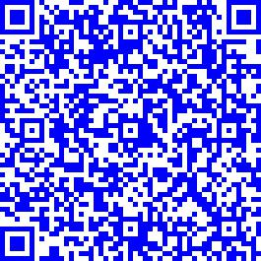
Period 7 – Learning Center
Congratulations! You have successfully made it to Learning Center with Mrs. Eason.
Your last class is World Language with Mr. O’Sullivan in room w217.

Slide 12
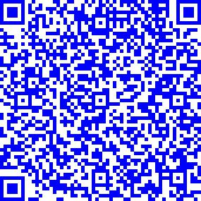
Period 8 – World Language
Congratulations! You have successfully made it to World Language with Mr. O’Sullivan.
Your class schedule is done, but you still have some more places to go. Head downstairs to guidance for your next clue.

Slide 13
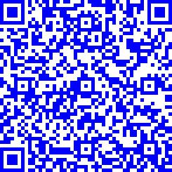
Guidance Department
Congratulations! You have successfully made it to the guidance department.
Head back toward the main office and find the school nurse.

Slide 14
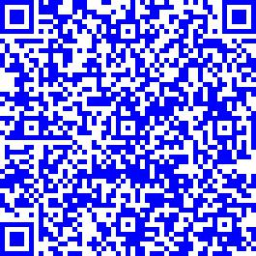
School Nurse
Congratulations! You have successfully made it to the nurse’s office.
This next one is a little harder. Head for the choir and band room for your next assignment.

Slide 15
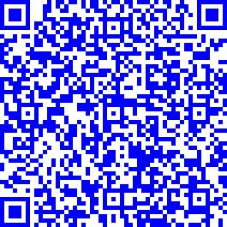
Complete the Journey
You have performed triumphantly! You have successfully made to the music area of the school.
Complete your tour by returning this iPad to Mr. Fernandes in N218.

Slide 16
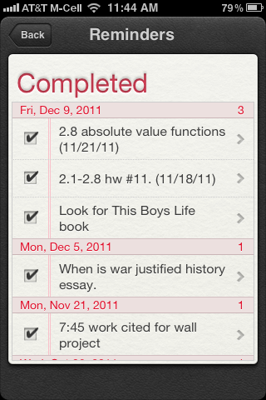
Lesson 3
Using iPhone Reminders
This is a screen shot of a students iphone with completed assignments.
In order to track completion of assignments, students are asked to take screen shots and email them to me every couple days.
I can then go into their grades to cross-reference whether or not assignments have been turned in and correlation between homework completion and quiz grades.

Slide 17
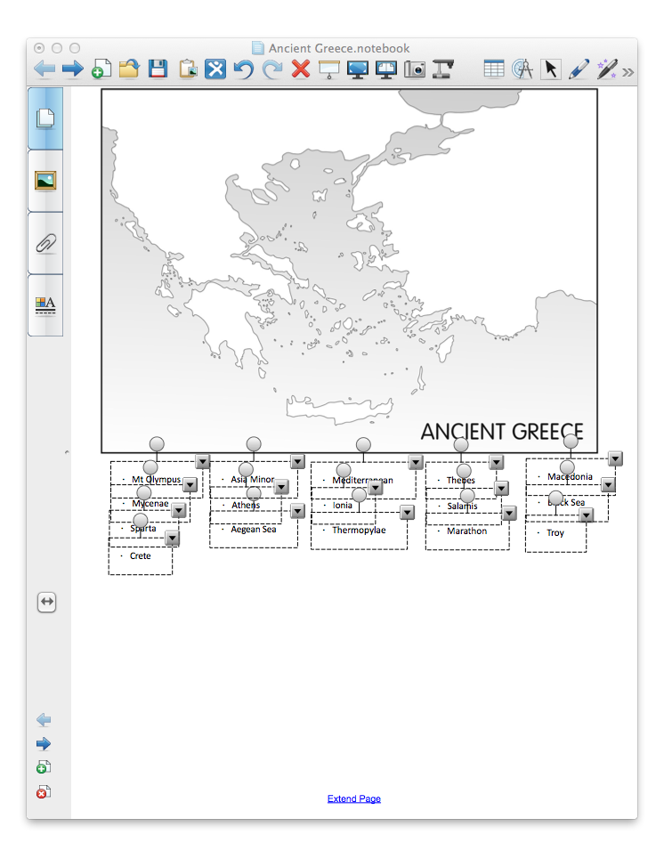
Lesson 4
Using Notebook Software
This was a map identification quiz that was modified for a student with Dysgraphia.
In order to complete the quiz, he simply had to drag and drop each city to its corresponding position on the map. The file can then be printed and sent to the teacher.
Benefits of notebook software are that if there is one SmartBoard in the school, the software can be installed on any computer, so the student doesn’t necessarily need a SmartBoard to use the technology.

Slide 18
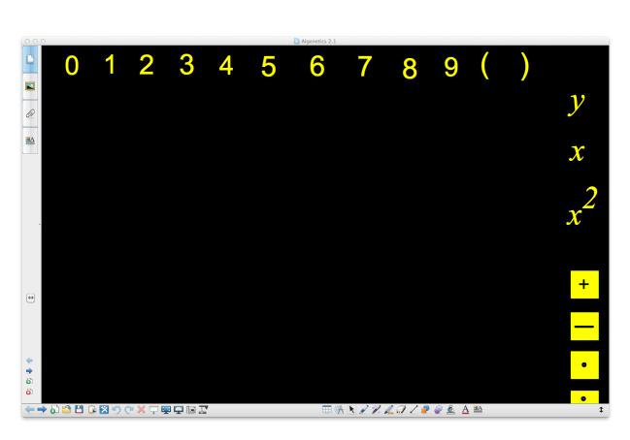
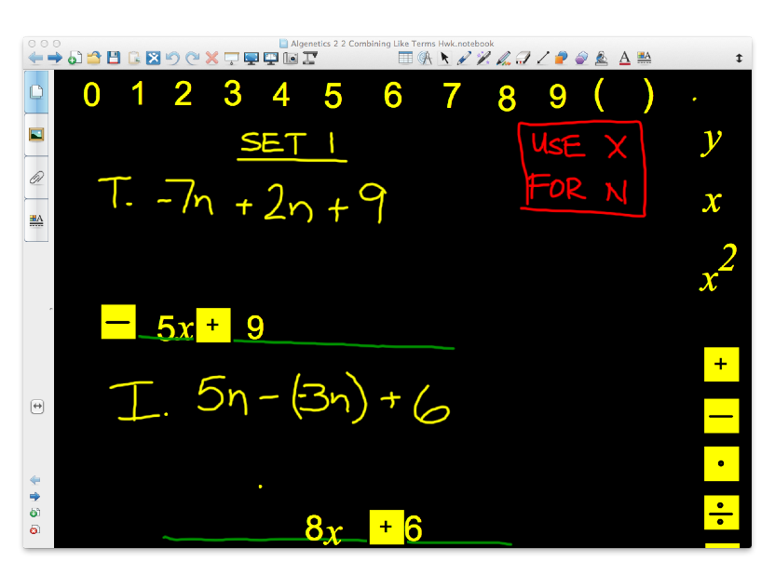
Lesson 5
Notebook Software 2
This notebook file was created for a student with Osteogenesis Imperfecta.
The student has limited motor skills and has difficulty writing, but can use a mouse with some efficiency.
The student is set up with a wireless mouse while I stand at the SmartBoard and write sample problems on the board. The student is then able to choose from the number and symbol clones on the border to drag and drop to complete the problems.

